Slide 1




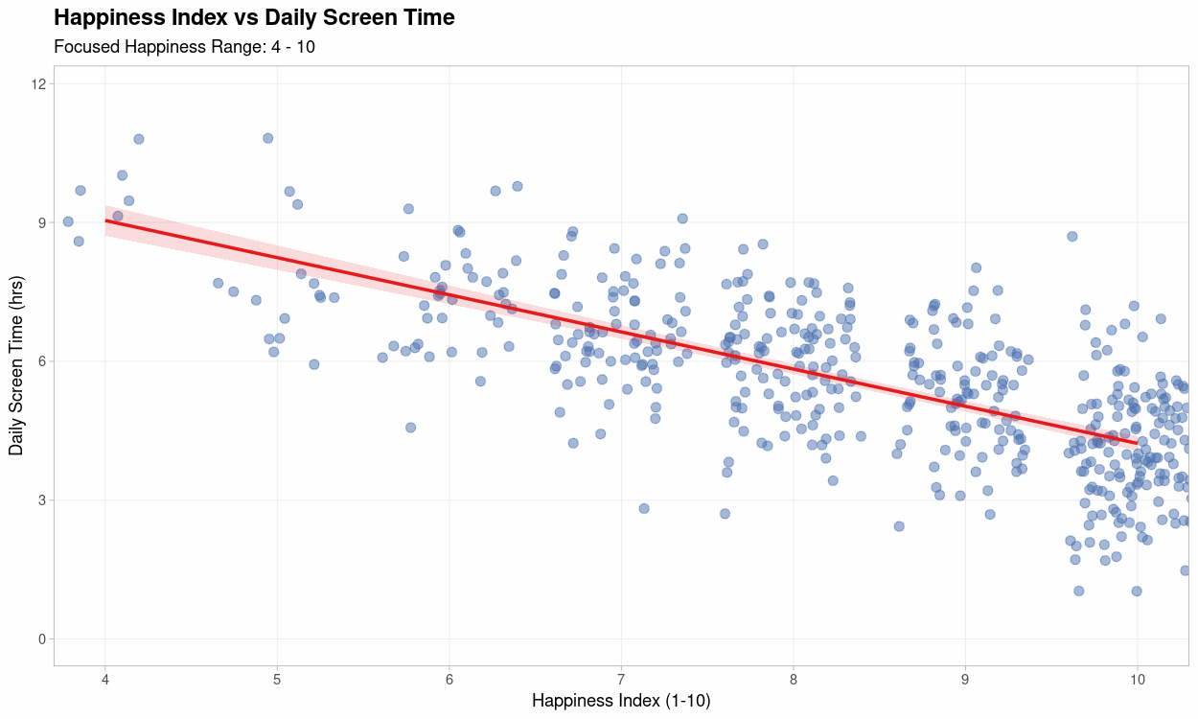
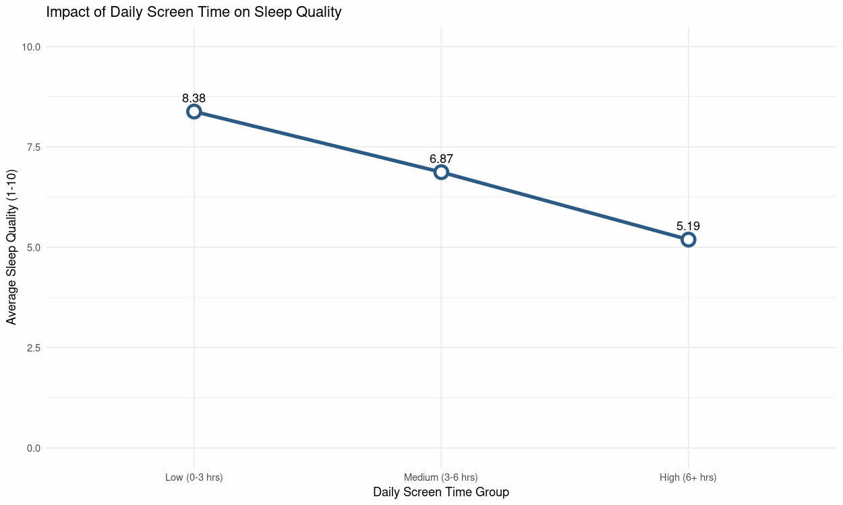
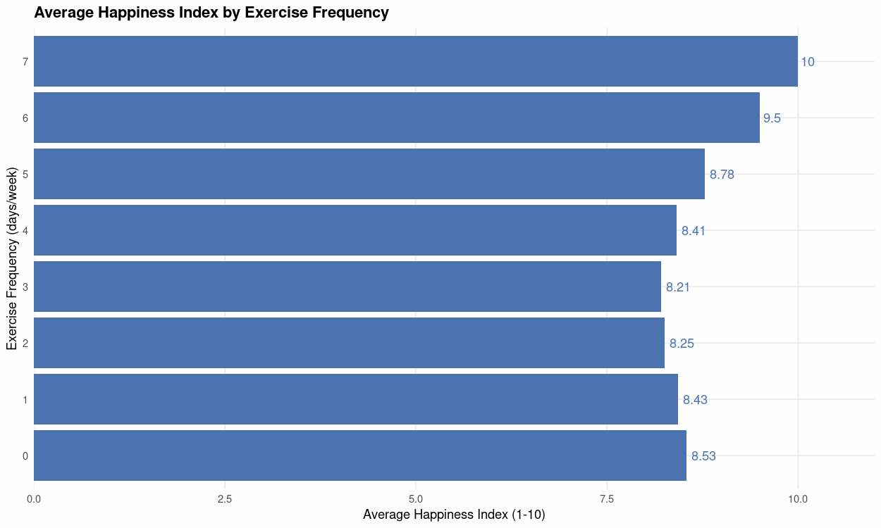
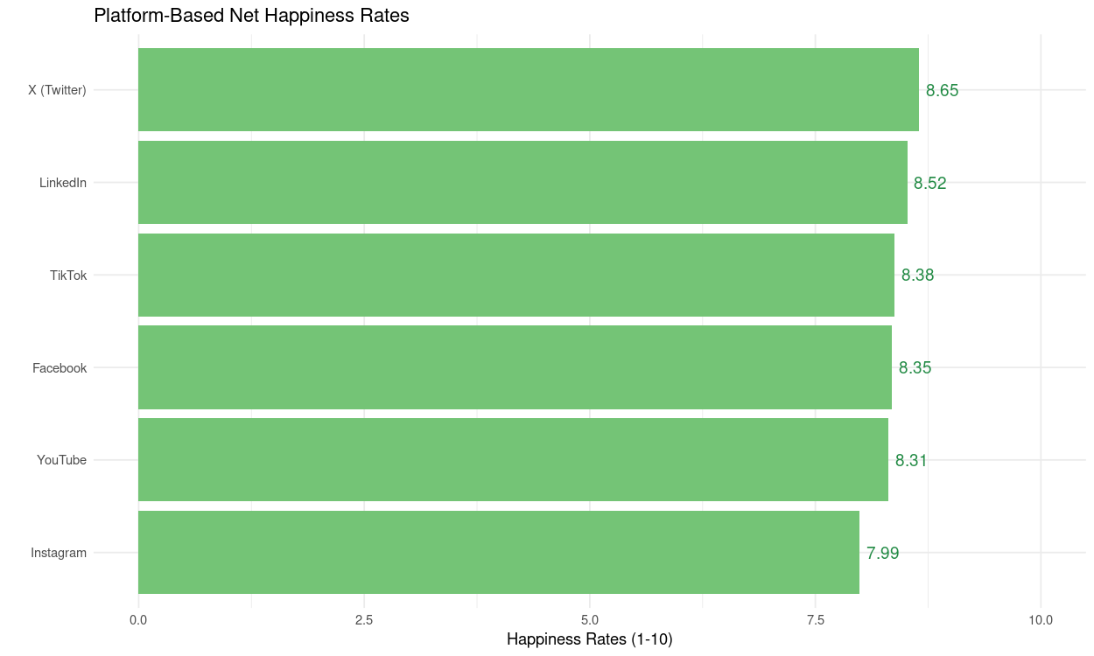
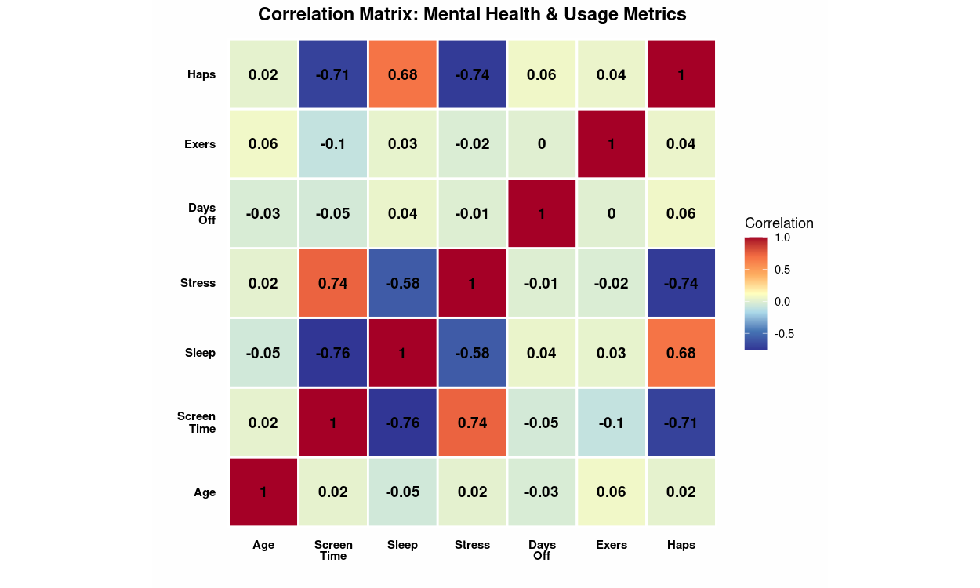

Analyzing the Effect of Daily Habits on the Happiness Index
Batuhan Denizli
batuhandenizli@ogr.eskisehir.edu.tr
How much happiness do our routines bring us?
Is happiness a coincidence, or a result of our habits? Based on data from 500 American citizens, this analysis reveals the direct impact of our daily choices on our mood.
Uncontrolled hours spent in front of screens not only disrupt your sleep; data proves that declining sleep quality directly lowers your happiness index. For higher life energy and happiness scores, end the night with a restful sleep that refreshes your mind, not with screens.
Constant notifications and digital consumption are silently increasing your stress levels. The graph clearly shows how stress rises as screen time increases. Remember; the lower your stress level, the higher your happiness index. Take digital breaks to let your mind breathe.
Happiness is not just a mental state, but the result of physical effort. The graph shows how the happiness index steadily increases as the frequency of weekly exercise increases.
It's not just about how much time you spend, but also when you arrive. Data shows that different platforms have different effects on users' happiness index.
Conclusion
Recommendations
Happiness isn't a matter of chance;it's the result of a balance between sleep, technology use,and physical activity.Healthy habits play a key role in stress management.
Establish Digital Balance
Choose an Active Lifestyle
Prioritize Sleep Quality
Mindful Technology Use
Make Small Changes
Source:https://www.kaggle.com/datasets/prince7489/mental-health-and-social-media-balance-dataset
https:// https://github.com/batuhandenizli

